Slide 1
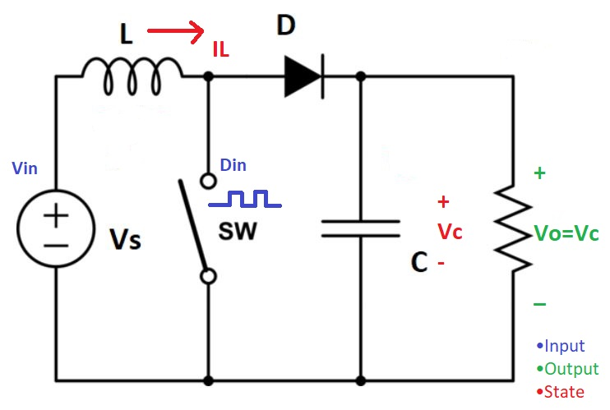
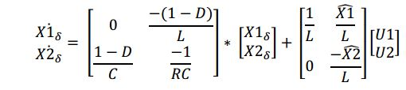

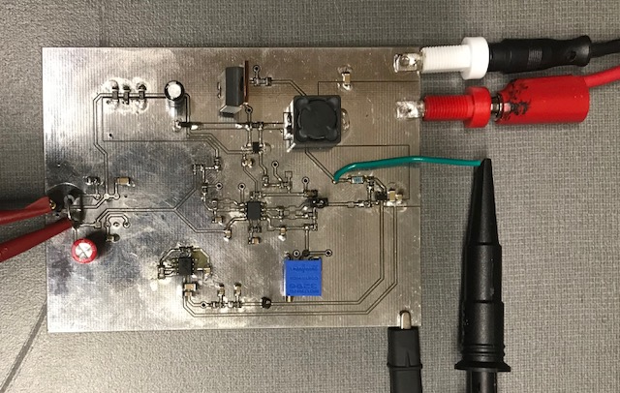
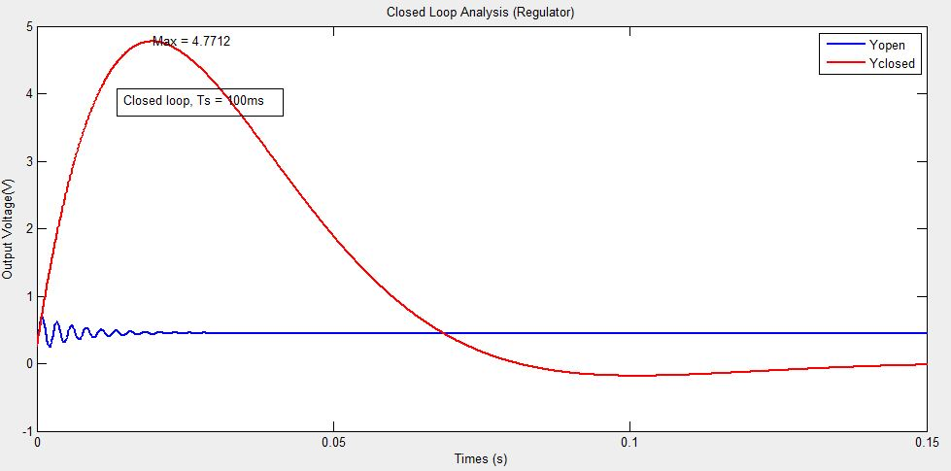
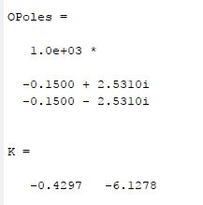
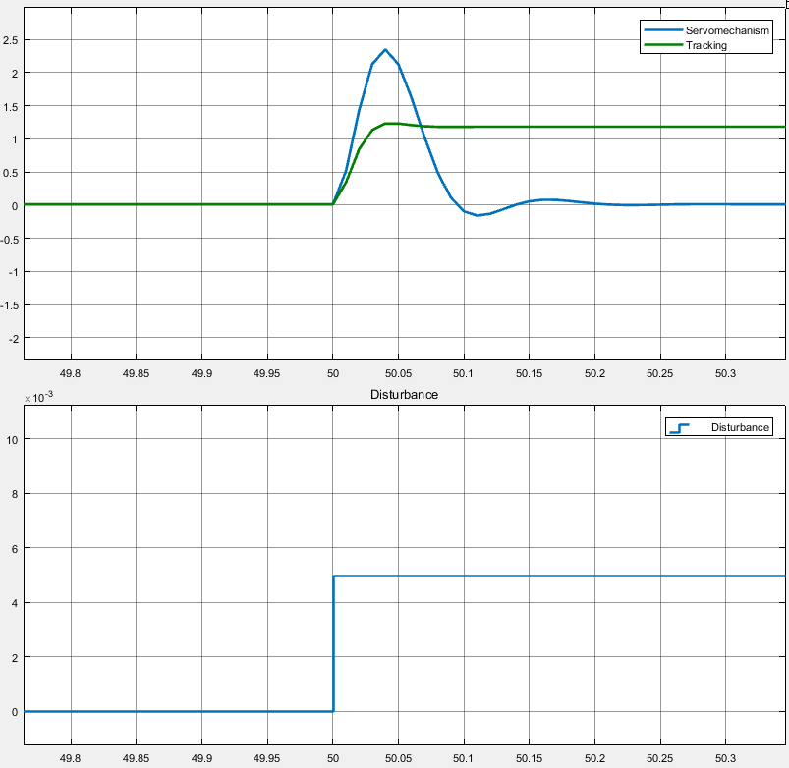
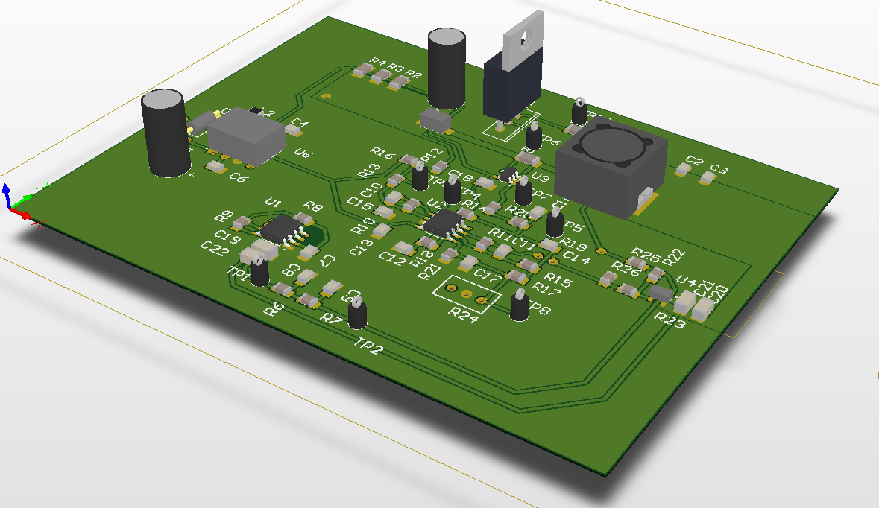
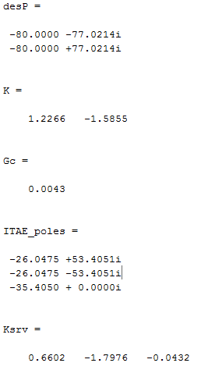
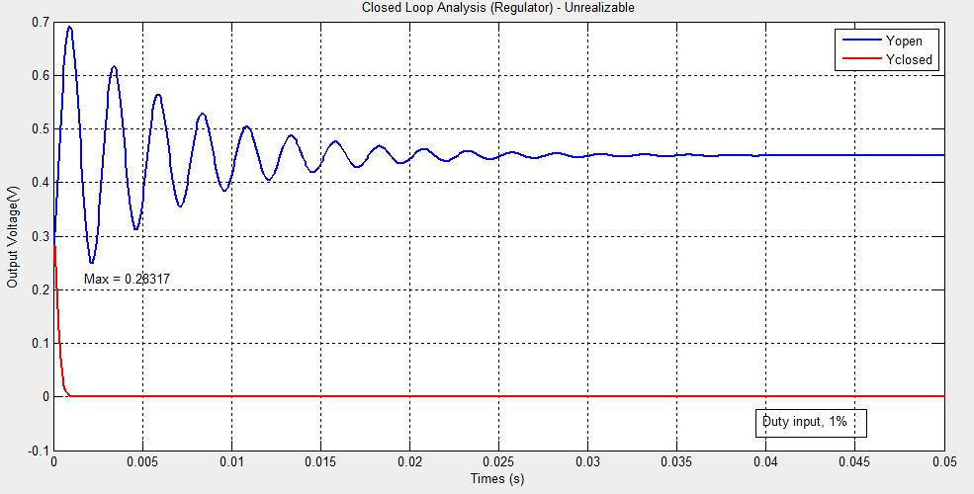
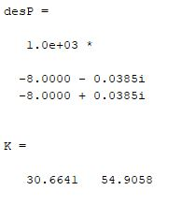
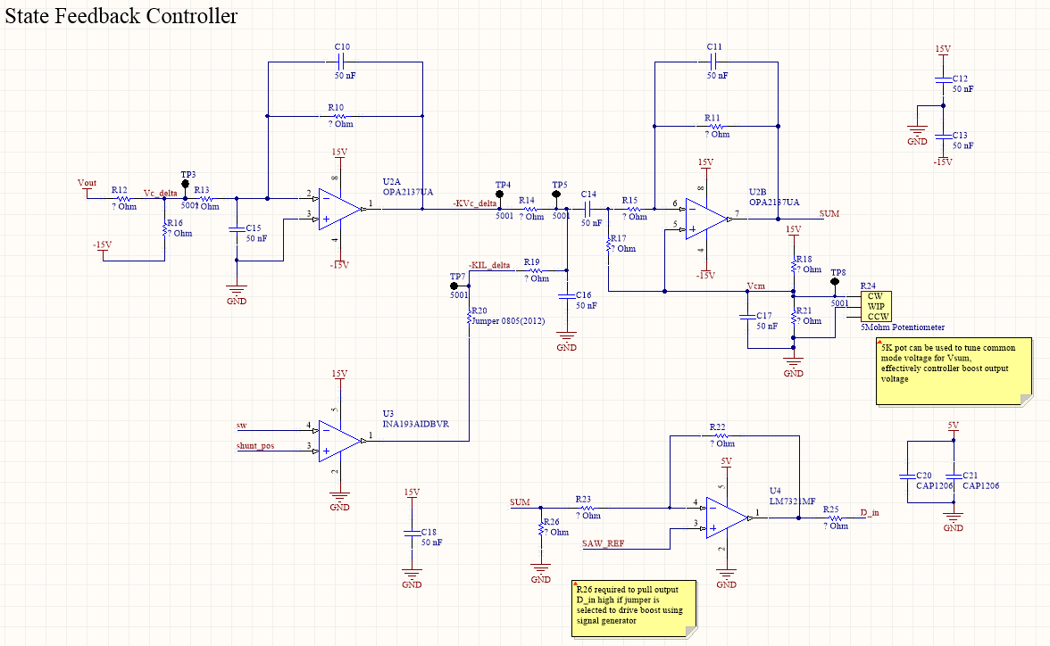
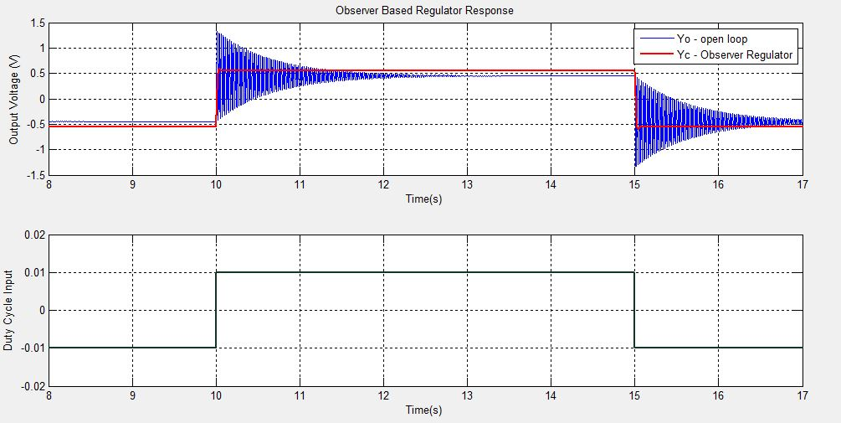
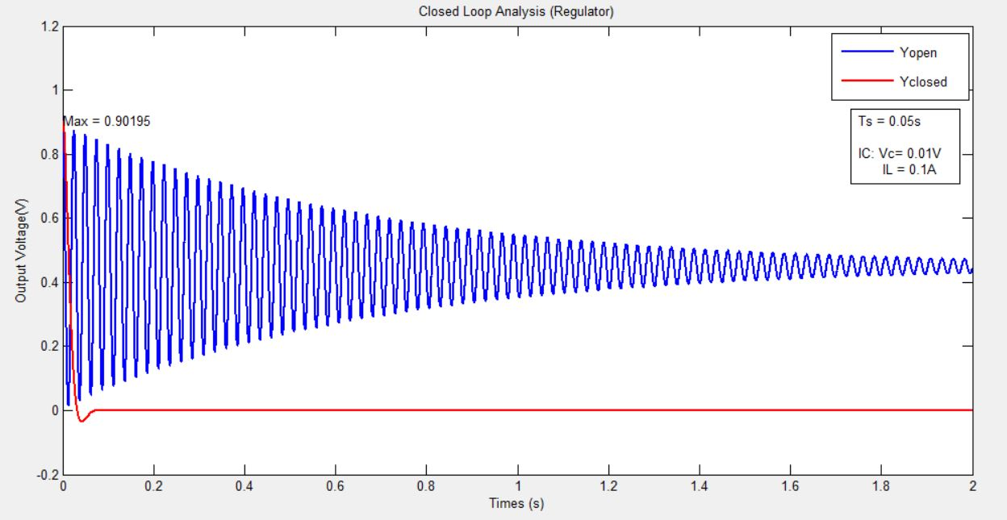
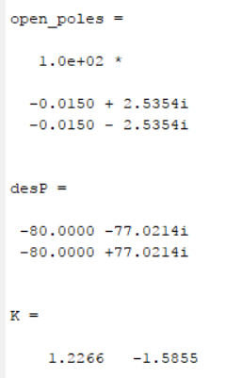
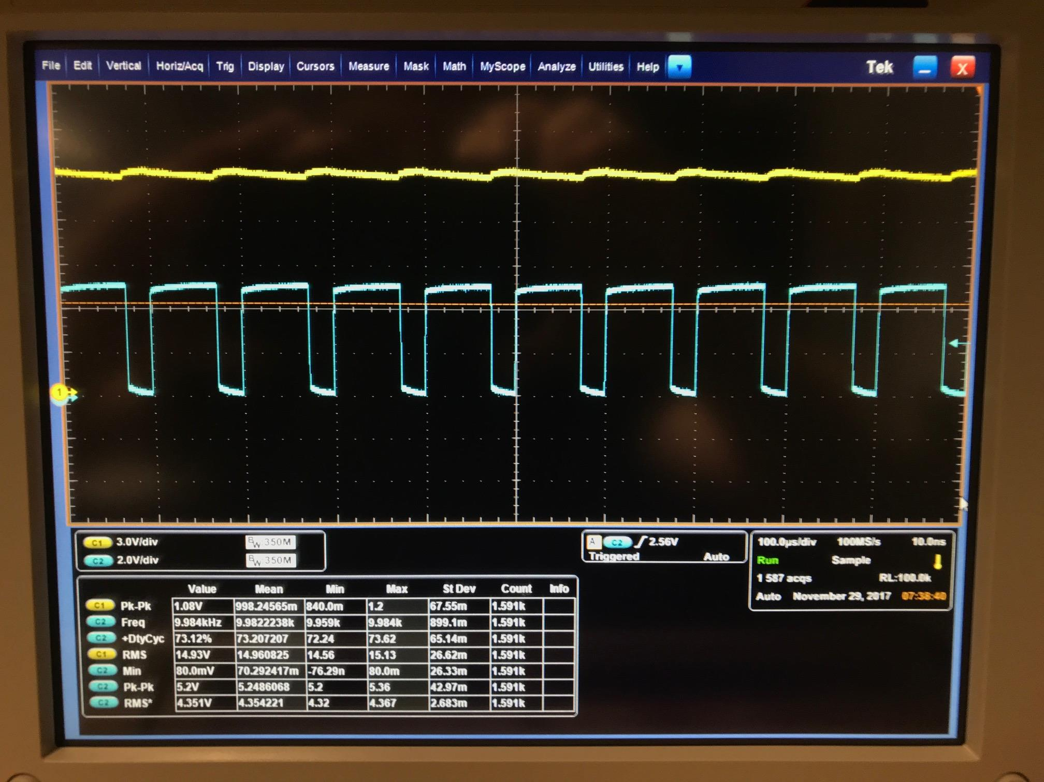
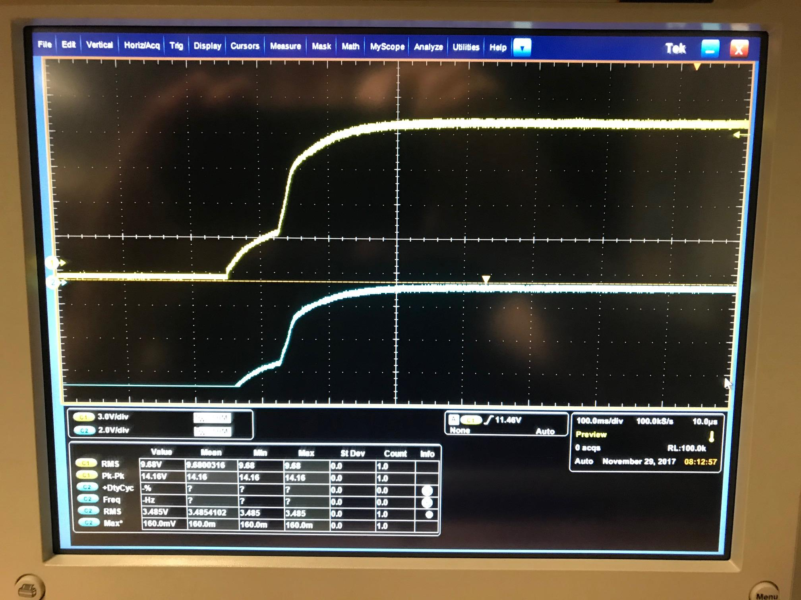

Boost Converter State-space Modelling
Multi-Input single Output (MISO)
Two operating modes:
SW ON
SW OFF
Combine modes to create weighted-average model
Linearization necessary to create small-signal model around EQM
GOAL: regulate output voltage Vo using duty cycle (Din) with
15V output
0.5W rated power
Linearized State EQTs:
$${H(s)}_{1x2}= \frac{1}{s^{2}+\frac{s}{RC}+\frac{{(1−D)}^{2}}{LC}}∗\left[\begin{matrix}\frac{(1−D)}{LC} & \frac{\left(1−D\right)∗\hat{V_{c}}−\hat{I_{L}}Ls}{LC}\end{matrix}\right]$$
System Dynamics
Controller Performance
Hardware Prototyping
Observer Design
Equilibrium, Steady-state Output
Linearized State Response
Output Voltage
Output Voltage
Gate Voltage, duty input
Capacitor voltage, error
Due to power constraints, R is very large, C & L are small (large open-loop poles)
For small %OS, closed loop poles must be left of open loop
For desired performance, unrealizable K is required
Compromise: increase capacitance, lower K, O-poles further right
Measuring inductor current is costly and inconvenient
Implementing an observer allows direct control over output voltage using only capacitor voltage state
Observer based regulator provides suitable performance, easier implementation in hardware as less computation required (can be achieved as analog)
Mitchell Johnston

